Slide 1



the role of variables, data types, input and output functions, and conditional statements in creating interactive programs.

Slide 2
DATA DYNAMOS Duncan NUKERI SIPHIWE MKHWANAZI NOZIPO NTIYO LERATO MOTAUNG KHENSANI KUBAYI shamaine mukhithi
VARIABLES
DATA TYPES
INPUT AND OUTPUT FUNCTIONS
CONDITIONAL STATEMENTS

Slide 3

VARIABLES

Slide 4

What is a Variable ?​
Variables are a fundamental concept in computer programming, serving as the basic building blocks for storing and manipulating data.​
Based on the data type of a variable, the computer's memory allocates space and determines what can be stored in the reserved memory. Therefore, by assigning different data types to variables, you can store integers, decimal values, or characters in these variables.

Slide 5
Rules for Python Variables
A variable name must start with a letter or the underscore character
A variable name cannot start with a number.
A variable name can only contain alpha-numeric characters and underscores (A-Z, 0-9, and _)
Variable names are case-sensitive (age, Age and AGE are three different variables)
Spaces are not allowed in variables, but underscore can be used to separate in variable names.

Slide 6
Assigning values to variables
In Python, variables do not require explicit declaration to allocate memory. Memory reservation occurs automatically when you assign a value to a variable. The equal sign serves as the assignment operator to give values to variables.
The operand to the left of the = operator is the name of the variable and the operand to the right of the = operator is the value stored in the variable.

Slide 7
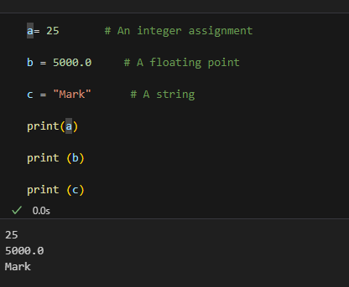
FOR EXAMPLE

Slide 8
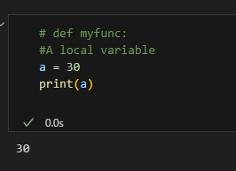
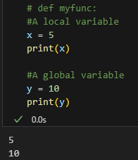
.
Local Variable
Global Variable
A variable declared within a function is called local variable. It is not callable outside the function.
A variable created in Python is usually a global variable, except for the case of local variable. It is callable anywhere in Python

Slide 9

CONCLUSION
A variable gives a name to a value
Choose a meaningful name
Reading and Assignment
A variable can be read in an expression
A variable can be changed in an assignment statement
The use of variables
To replace a complex expression with several simpler ones
To hold an ‘input’ string from the user.

Slide 10
DATA TYPES

Slide 11
WHAT ARE DATA TYPES?
Data types are fundamental in programming, serving as the building blocks for data management and interaction.

Slide 12
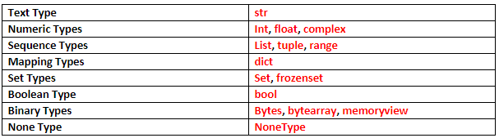
Python has the following data types built-in by default, in these categories:

Slide 13
IN Python, understanding data types—both primitive and composite—enhances our ability to create interactive applications that respond effectively to user input.
COMPOSITE DATA TYPES
Lists: Store collections of items, allowing dynamic user inputs like selections or responses.
Dictionaries: Key-value pairs used to manage data that requires quick lookups, such as user settings.
Tuples and Sets: Useful for fixed collections and unique items, respectively.
PRIMITIVE DATA TYPES
Integers (int): Represent whole numbers, useful for counting, indexing, or setting numeric parameters.
Floating-point numbers (float): Used for decimals, important in calculations involving currency or measurements.
Strings (str): Handle text data, critical for user inputs like names, messages, or commands.
Booleans (bool): Represent truth values (True or False), essential for decision-making processes.

Slide 14
Enhancing User Interaction Data types facilitate user interaction in several keyways:
Input Validation: Ensures that user inputs match expected types, minimizing errors. For instance, asking for a user’s age and validating it as an integer prevents crashes and incorrect data processing.
Data Manipulation: Different data types allow various operations. For example, lists support methods like append() and sort(), enabling dynamic changes based on user input. This flexibility is vital for applications that need to process user choices in real time.
Control Flow: C to execute different code paths. A boolean flag (e.g., is_logged_in) can determine access to certain features, tailoring the experience based on user status.

Slide 15
Error Handling and Feedback Effective error handling and user feedback are critical in interactive programs
Error Handling: By using try and except blocks, developers can gracefully manage type-related errors. For instance, if a user inputs a string when a number is expected, the program can catch the exception and prompt the user to enter a valid number, enhancing the user experience.
User Feedback: The clear presentation of information is crucial. Using formatted strings allows programs to communicate effectively with users. For example, displaying scores or statuses in a user-friendly manner improves clarity and engagement. .

Slide 16
Conclusion
In summary, data types play a vital role in developing interactive programs. They facilitate input validation, enable data manipulation, and govern control flow, all of which are essential for creating responsive applications. Furthermore, robust error handling and clear user feedback enhance usability, ensuring that programs can interact effectively with users.
Understanding how to leverage data types not only leads to smoother functionality but also enriches the overall user experience, making your applications more intuitive and reliable. As you develop interactive programs, always consider the role of data types in shaping how users interact with your application.

Slide 17
INPUT FUNCTIONS

Slide 18
WHAT IS INPUT FUNCTION
User input is a fundamental concept the allows developers to create interactive and dynamic applications. You can define the input function using the built-in input() function which will allow developers to get user input from the console. This function prompts the user to enter data, which is then captured and stored as a string.

Slide 19

THE IMPORTANCE OF USER INPUT
User input is a crucial aspect of software development as it allows programs to adapt to the needs and preferences of the end-user. By accepting input from the user, applications can become more personalized, responsive, and tailored to the user's specific requirements.
Practical Examples and Application of User Input
Data entry
Configuration settings
Menu driven application

Slide 20
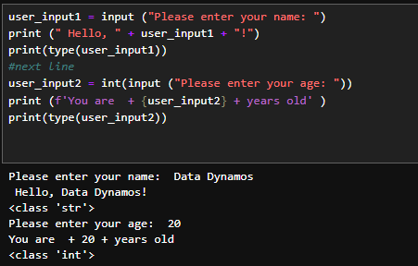
Handling Different Data Types
By default, the input() function returns the user's input as a string. However, in many cases, you may need to convert the input to a different data type, such as an integer, boolean, float, string. Python provides several built-in functions for this purpose:
int(user_input)
float(user_input)
bool(user_input)
str(user_input)

Slide 21
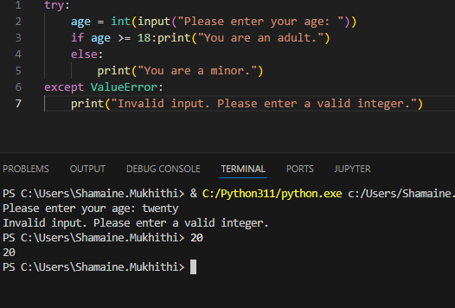
Handling INVALID INPUTS
When working with user input, it's important to consider the possibility of invalid input. You can use exception handling techniques to handle these cases and provide appropriate error messages.

Slide 22
OUTPUT FUNCTIONS

Slide 23
WHAT IS OUTPUT FUNCTIONS
Output functions in creating interactive programs are methods that display or communicate information to the user.

Slide 24

Output functions play a crucial role in creating interactive programs by:
Displaying results: Showing calculated or processed data.
Providing feedback: Informing users about input validity or errors.
Guiding user interaction: Prompts, menus, and instructions.
Visualizing data: Charts, graphs, and other visual representations.
Enhancing user experience: Animations, transitions, and effects.

Slide 25
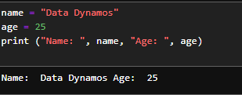
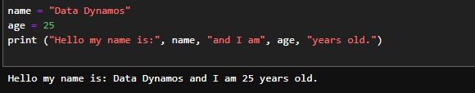
Print () it is used to display the output on the console
In this code , we are passing two parameters name and age to the print function
Text in double quotes will consider as Normal text and display on output screen

Slide 26
CONDITIONAL STATEMENTS

Slide 27
WHAT ARE CONDITIONAL STATEMENTS
Conditional statements in Python are used to control the flow of a program based on conditions or decisions. They allow your code to execute different actions depending on specific conditions.

Slide 28
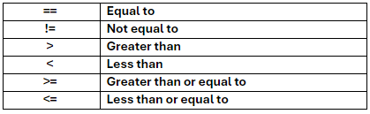
CONDITIONAL OPERATORS

Slide 29

LOGICAL OPERATORS
And (&&) (Both conditions must be true)
We use the And keyword as logical operator to combine conditional statements: Test if a is greater than b, AND If c is greater than a.
Or (/) (At least one condition must be true)
The Or keyword is also a logical operator that is used to combine conditional statements: Test if a is greater than b, OR if a is greater than c.
Not (!) (Negates the condition)
The Not keyword is a logical operator, and is used to reverse the reverse of the conditional statement: Test if a NOT greater than b.

Slide 30
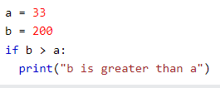
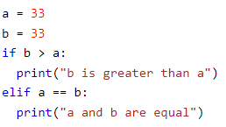
CONDITIONAL STATEMENTS
If-Elif Statement
The Elif keyword is a way of saying "if the previous conditions were not true, then try this condition.
If Statement
An If statement is used to execute a code if the condition is true.

Slide 31
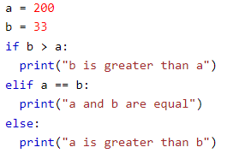

CONDITIONAL STATEMENT
Short Hand If
If you only have one statement to execute, you can put it on the same line as the if statement.
If Else Statement
The else statement catches anything which isn't caught by the preceding conditions.

Slide 32

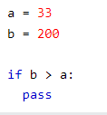
CONDITIONAL STATEMENTS
The pass statement
If statements cannot be empty, but if you for some reason have an If statement with no content, put in the pass statement to avoid getting an error.
Short Hand If...Else
If you have only one statement to execute, one for if, and one for else, you can put it all on the same line.

Slide 33

Thank you

